Slide 2
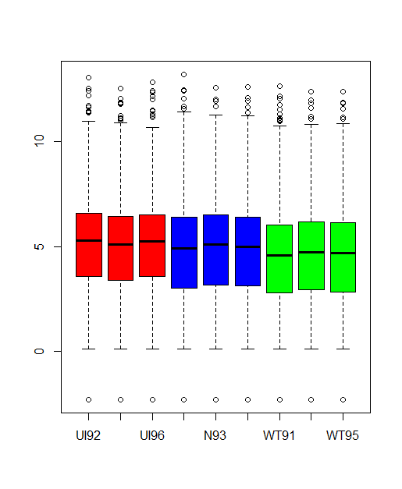
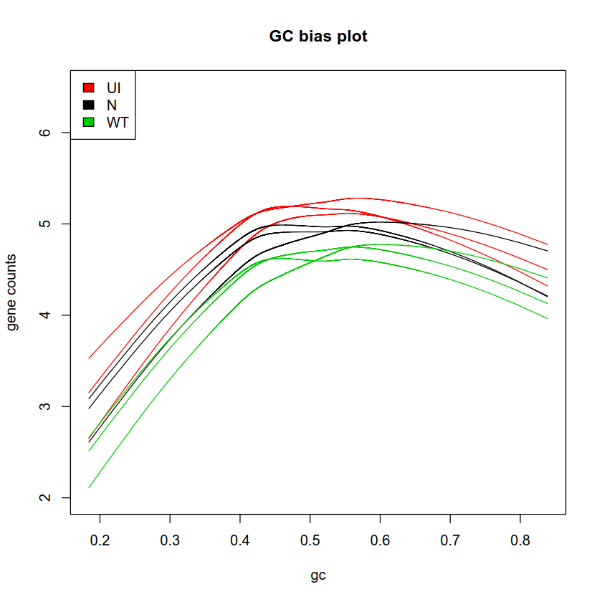
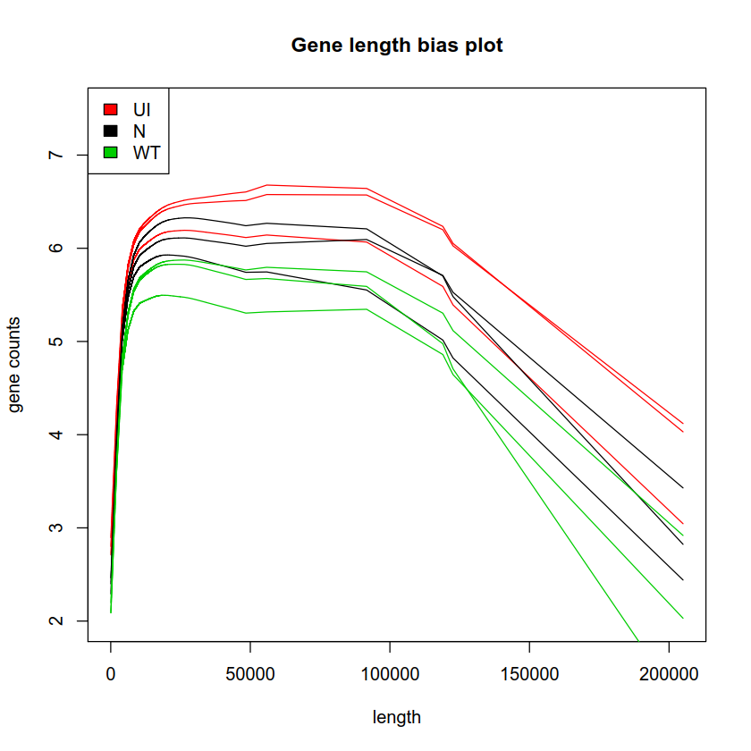
Notes:
Gene counts prior to within and between lane normalization

Slide 3
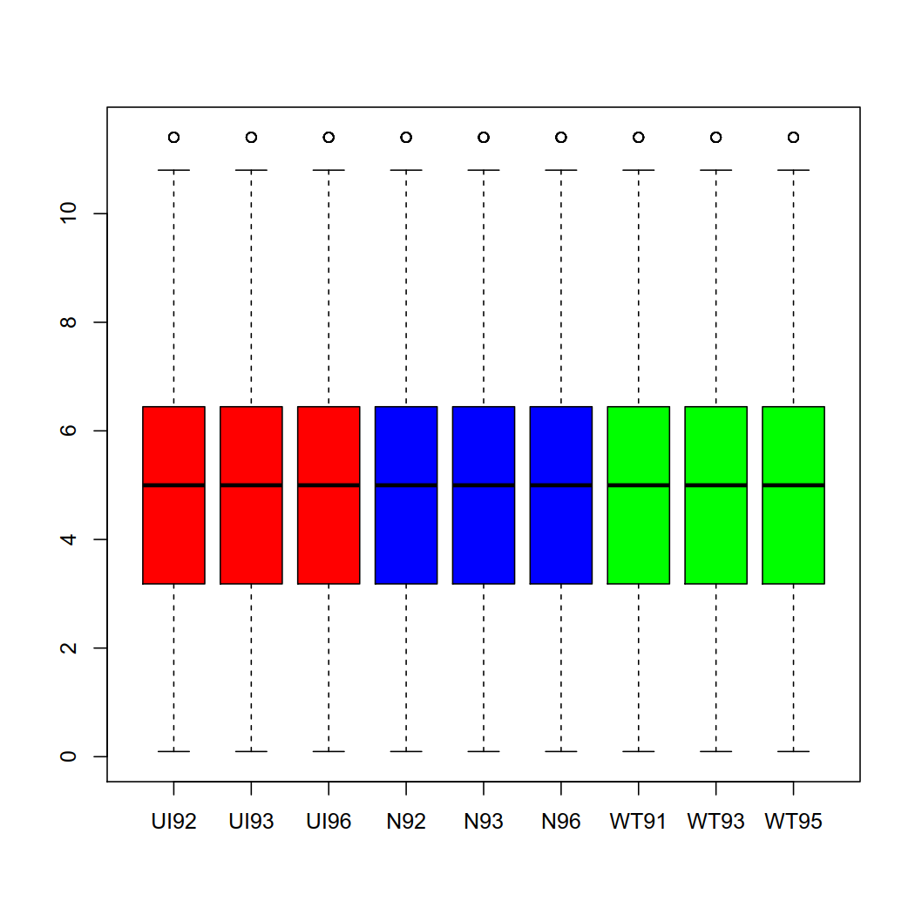
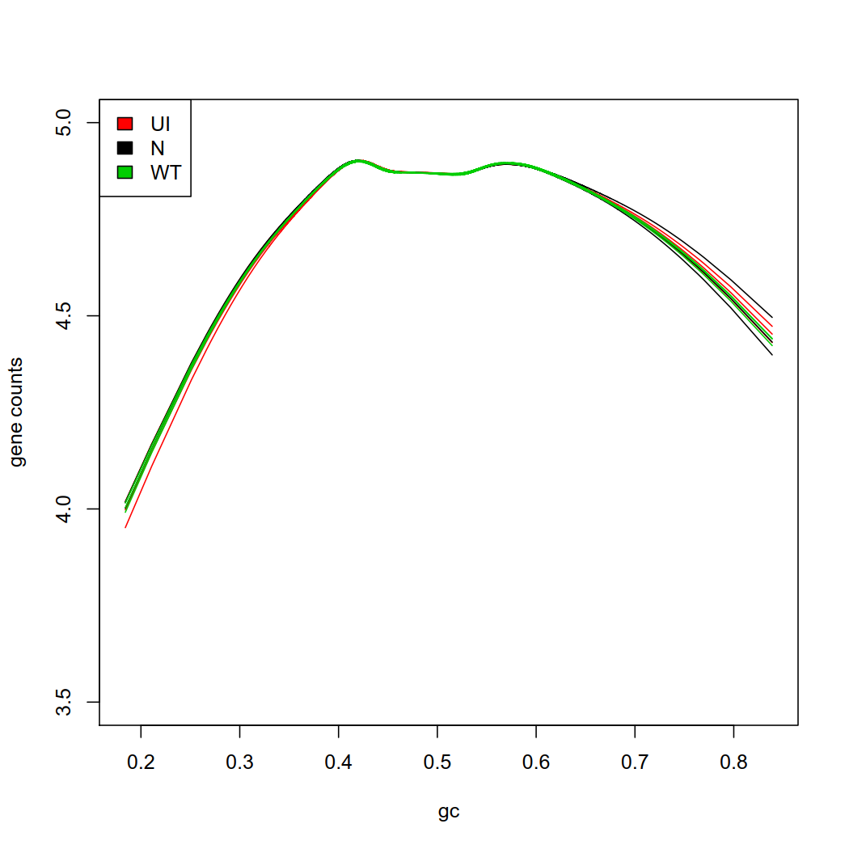
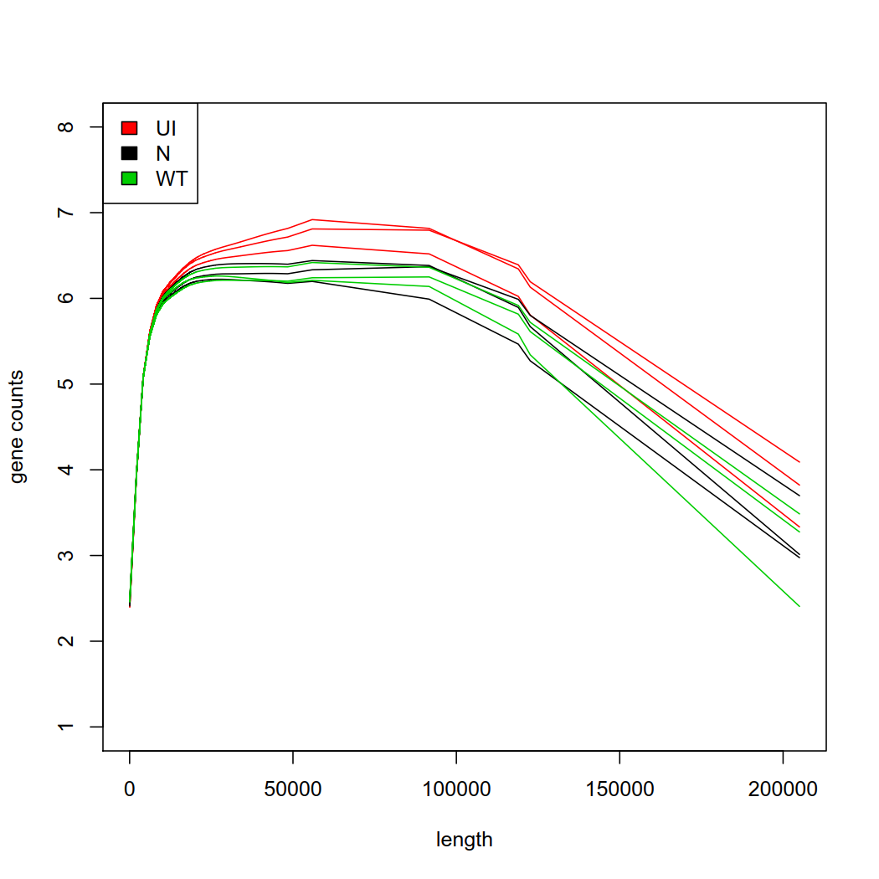
Notes:
Gene count plots after the normalization by EDAseq

Slide 4
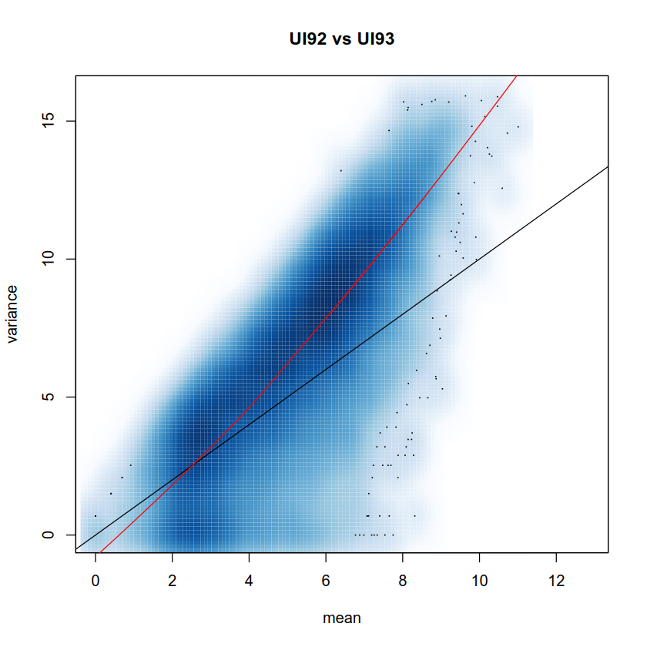
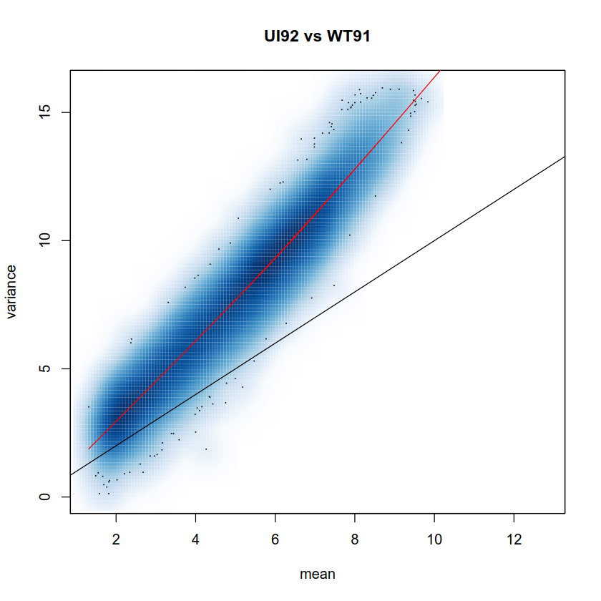
Notes:
Checking for over-dispersion, the points have to scattered around the black line within replicates and dispersed away between different conditions

Slide 5
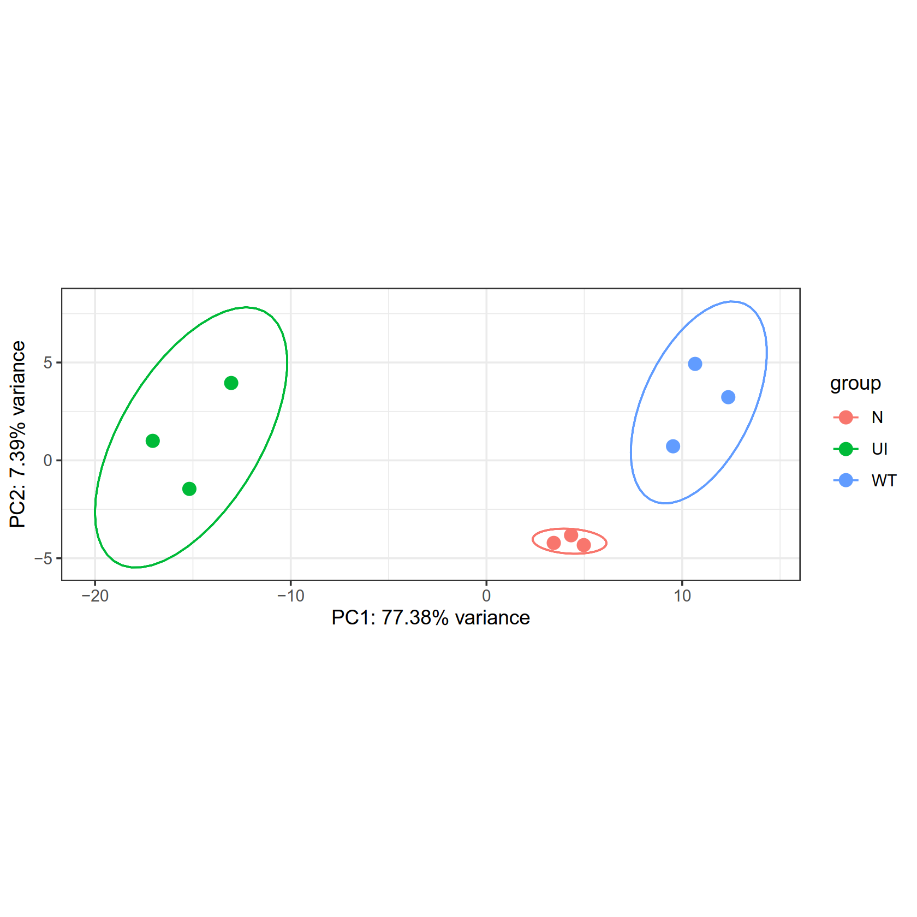
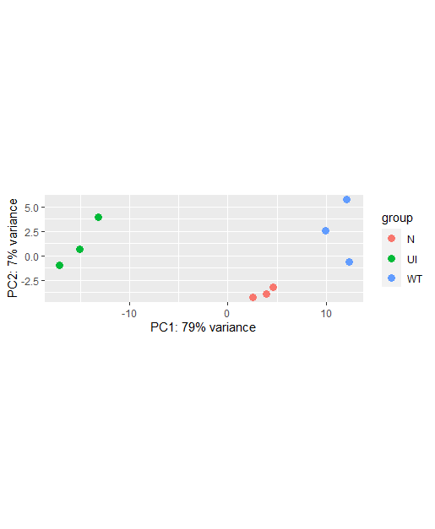
Notes:
PCA plot with normalized counts, PCA plot with unnormalized counts on the right

Slide 6
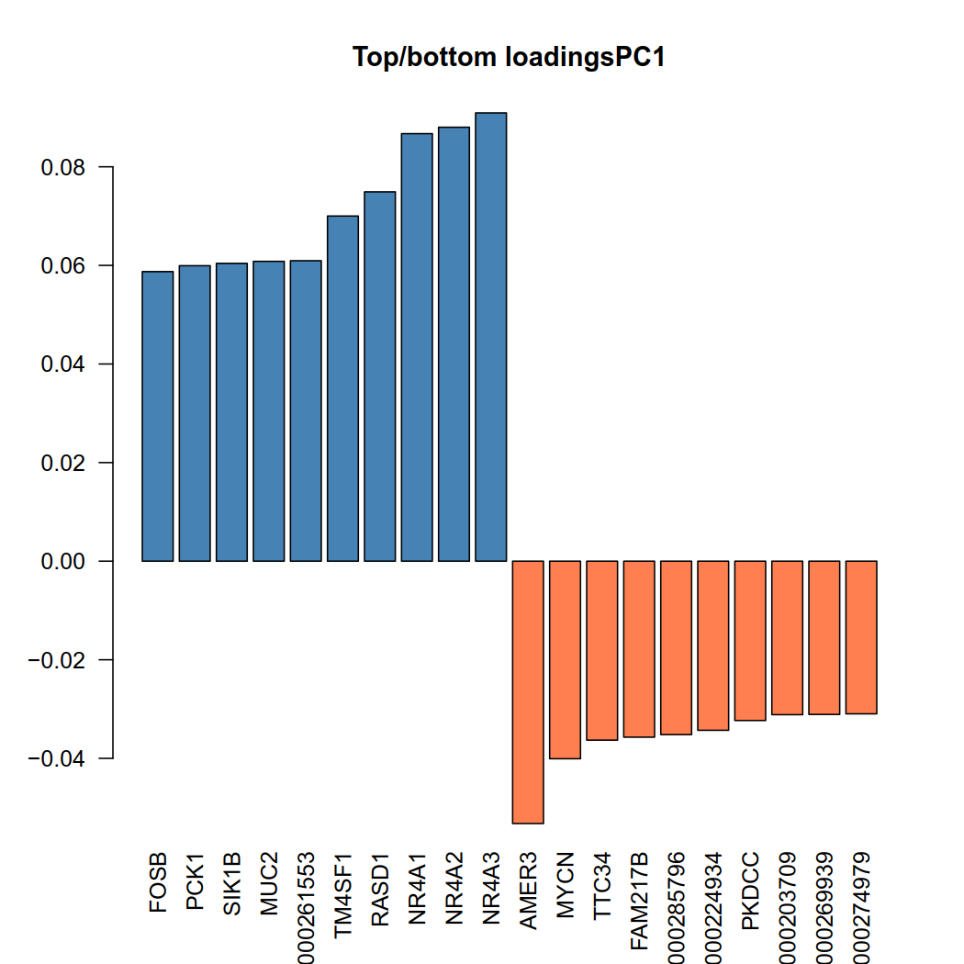
Notes:
The genes that drive the most variation along the Principal component 1 axis

Slide 7
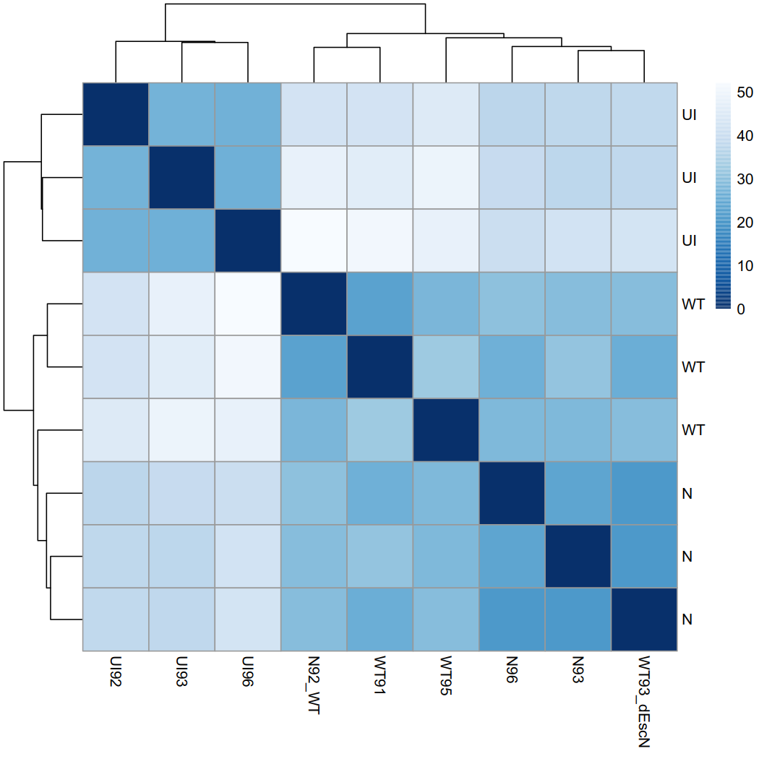
Notes:
Heatmap of sample distances

Slide 8
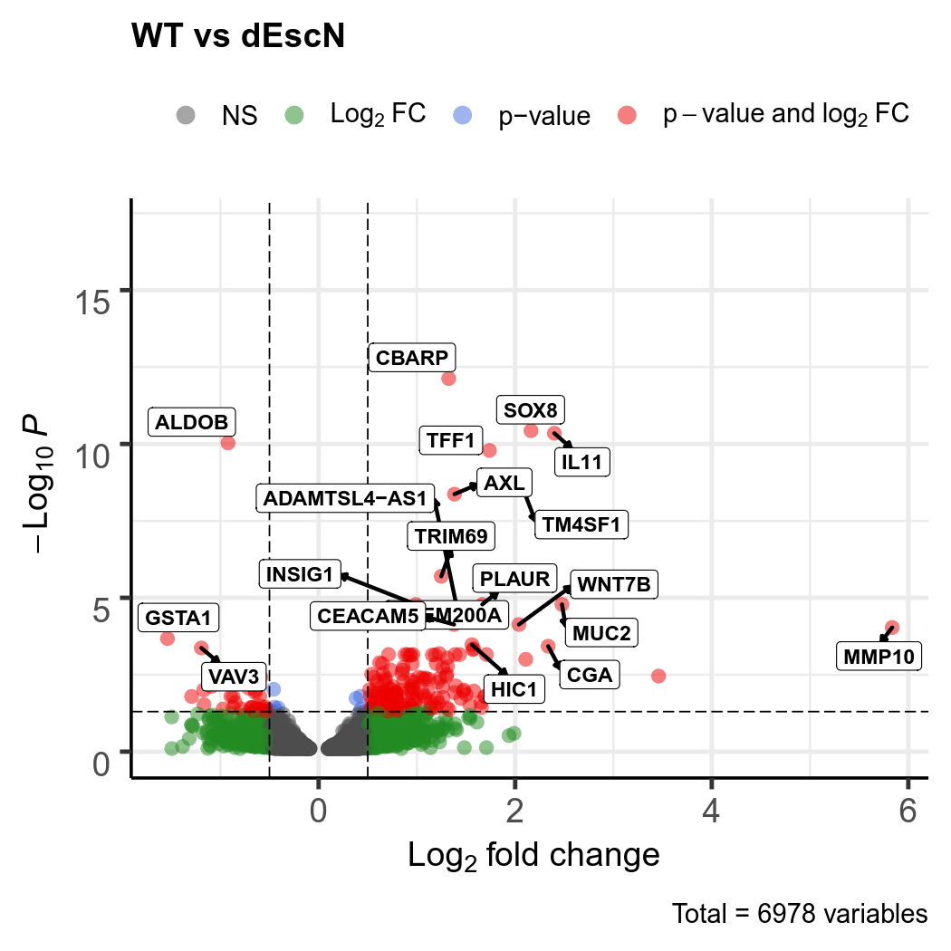
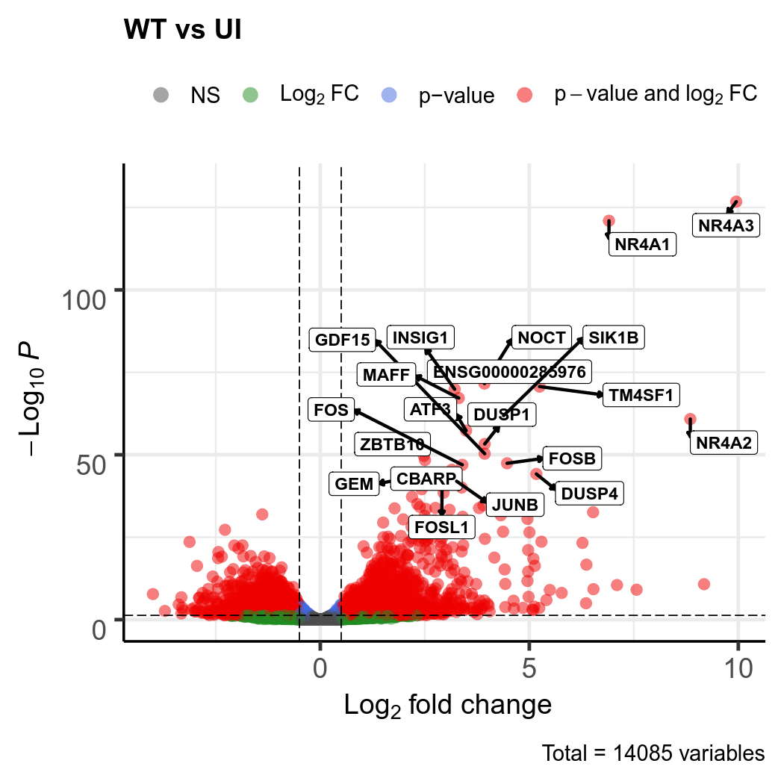
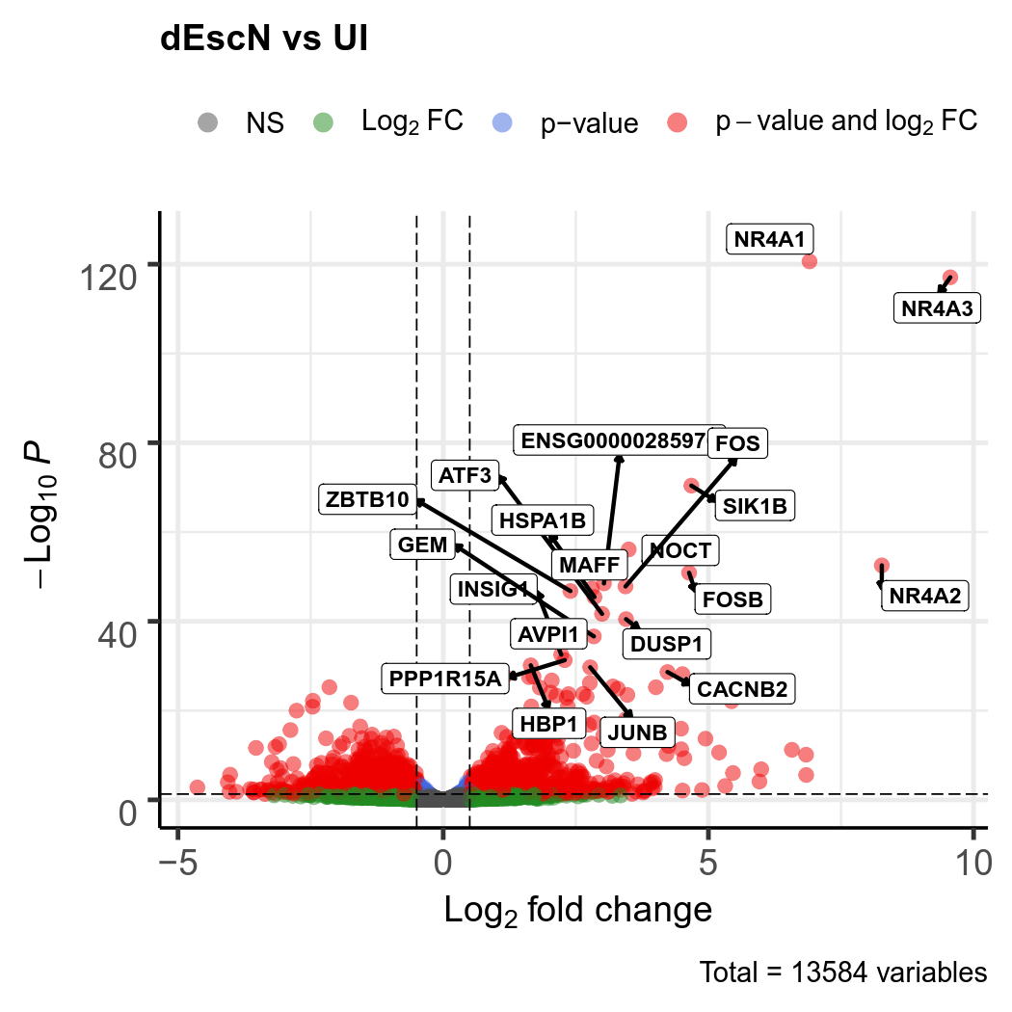
Notes:
Volcano plots, only analyze genes with padj <0.9. Also working with EDAseq normalized counts

